Slide 1
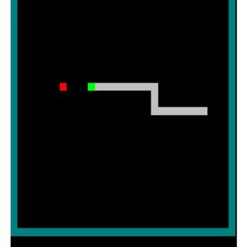
Project topic:
TRAINING THE AGENT SNAKE
Team Members:
Mahidar Reddy Uppalapati
Manasa Rangineni

Slide 2
STATEMENT OF
PROJECT
OBJECTIVES
The Agent Snake will play the whole game in a 16x16 grid
Agent gets rewarded for eating the food capsule
The game ends when the agent hits the wall
The goal of this project is to train an AI agent to perform well in a revised Snake game

Slide 3
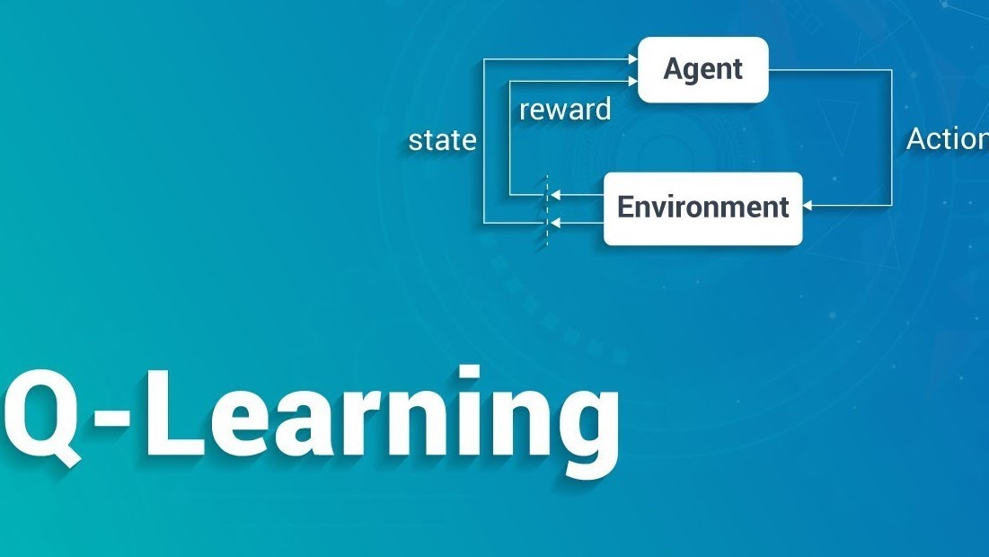
APPROACH
Q-learning Algorithm

Slide 4
DELIVERABLES
developed PYTHON CODE ALGORITHM (.PY FILE)
DOCUMENTATION REPORT (README.MD)
YOUTUBE VIDEO
GITHUB REPOSITARY LINK
PPT PRESENTATION (SLIDES)

Slide 5
EVALUATION METHODOLOGY
The success of the project is determined by the successful implementation of the Q-learning Algorithm.
The agent snake should be trained in such a way that it should not stuck back and forth in between the game.
It can be observed that the game score cannot be same for all the episodes.

Slide 6
